Slide 1


Utility-Led Solarization
Agent
Ener'gentic Hackathon 2025

Slide 2
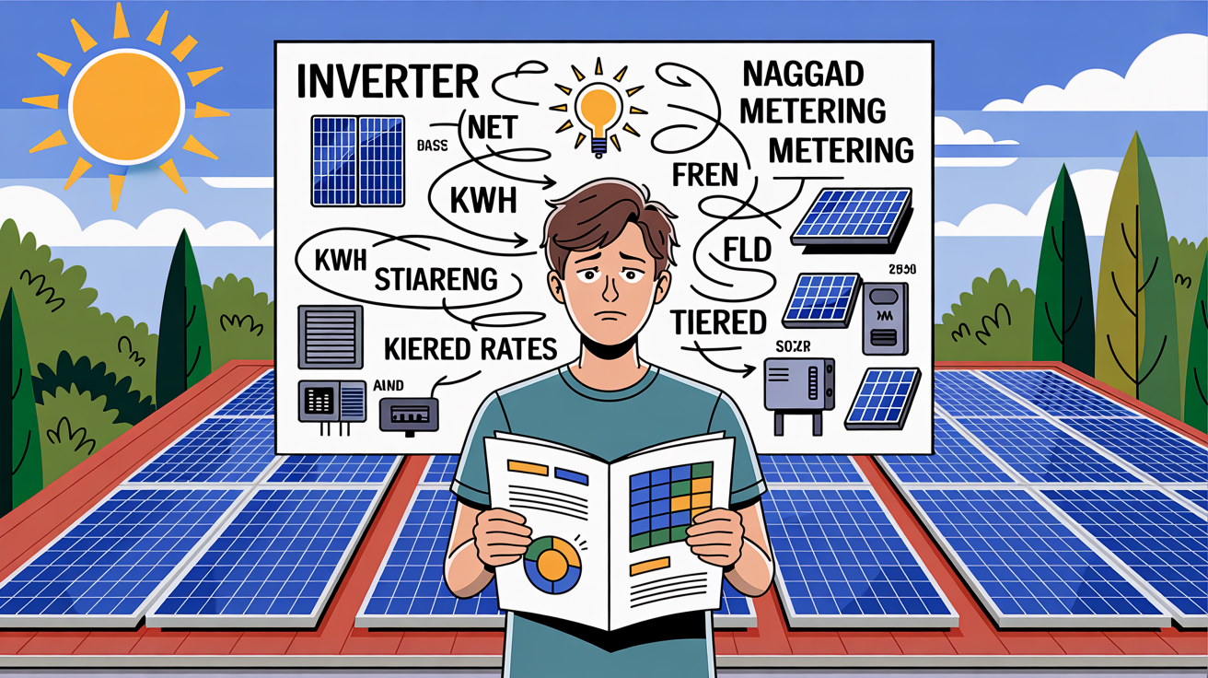
The Solar Adoption Challenge
Lack of consumer awareness
Financing options are unclear
Regulatory and administrative hurdles
Community energy sharing is underused

Slide 3
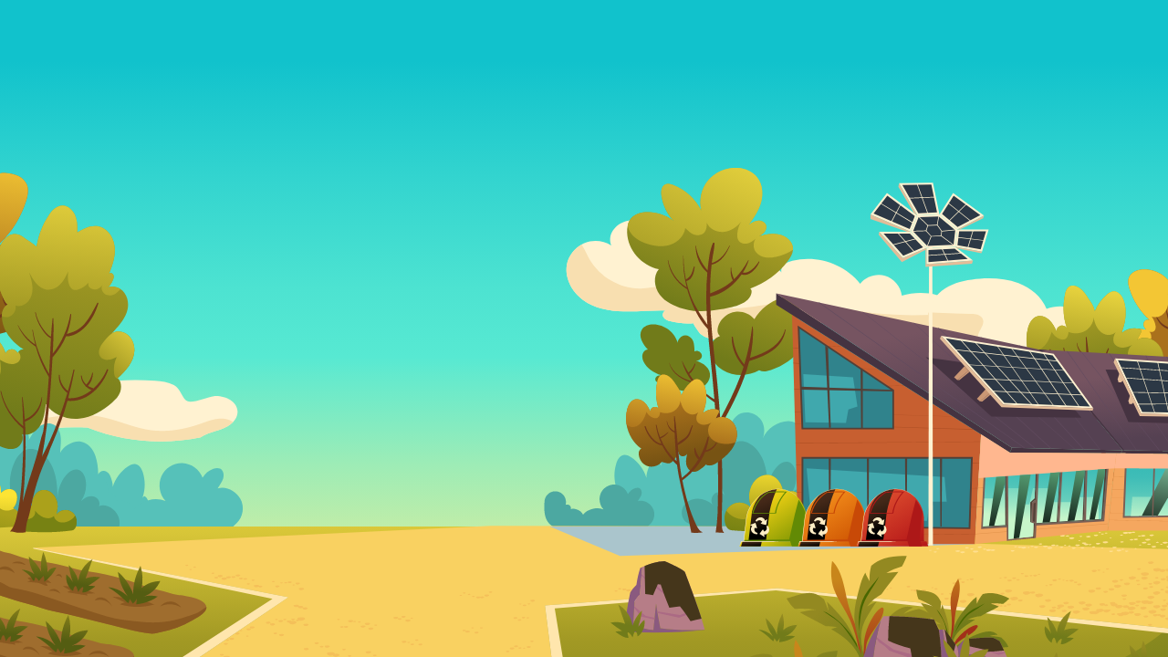

Meet Solar Agent
Chat in plain language
Personalized system and savings recommendations
Auto-handles subsidies, loans, and permits
Connects you to the right retailers and installers
Unlocks community energy sharing and rewards

Slide 4
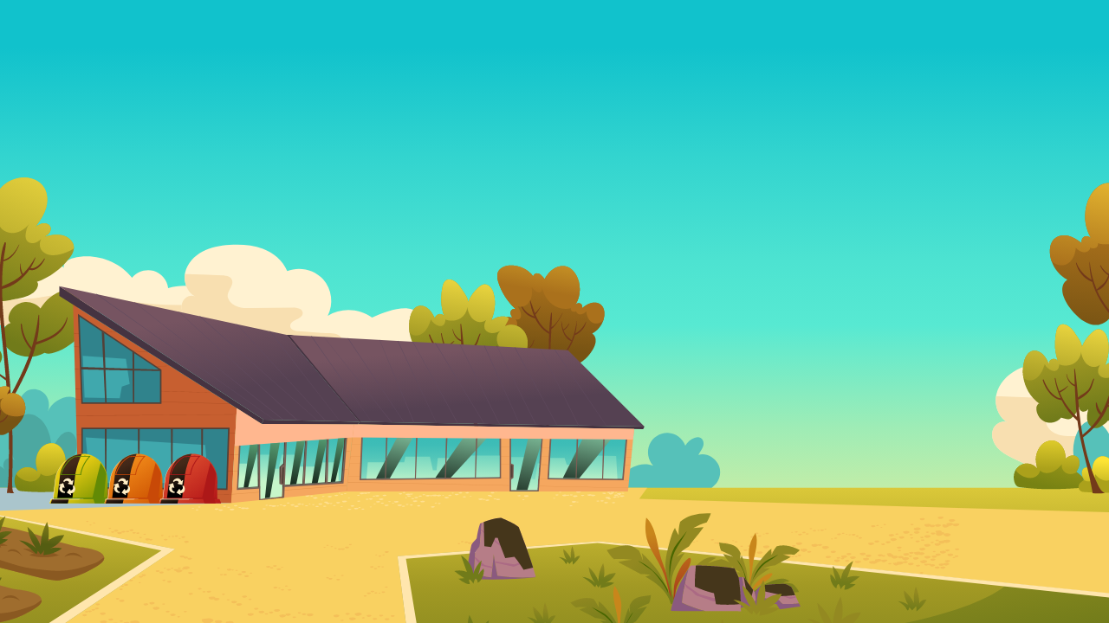


Chat with Solar Agent
Hey, I've been thinking about getting solar panels for a while now… but I have no idea where to begin.
Hi Rohit!
You're not alone going solar can feel like a maze. But I'm here to make it easy. Step by step, no jargon, no stress. Let's start by understanding your energy usage so I can tailor the best solar plan for you.

Slide 5
Cost estimate based on power consumption
My average monthly electricity bill is around Rs. 1200
Perfect, based on that, A 3.5 kW solar system should cover most of your needs.
Here’s a quick look: - Base cost: R45,000 - Solar incentive reduces it to R32,000 - With a green loan, your monthly payments could be less than your current bill. Would you like me to start the paperwork for the subsidy and financing?

Slide 6
Request for subsidy & financial documents
Yeah, that sounds reasonable. Let's do it.
Submitting subsidy request
• Prepping financing docs
• Matching you with 2 certified installers
I'll keep you updated at every stage.
You're now at: Step 2: Design + Permits This is where the installer designs your setup and we get approvals. Takes about 4–5 days.

Slide 7
Demand Flexibility Program (DFP)
Nice. So what happens once it's installed?
Once your system is up and running, you’ll receive:
1. A Green Energy Certificate
2. Registration for net metering or feed-in
3. A chance to join our Demand Flexibility Program (DFP)
Want to hear more about that?

Slide 8
Hmm, could you tell me more about it?
Absolutely. The Demand Flexibility Program (DFP) lets you maximize your solar impact:
- If your battery’s low, you can borrow or buy surplus solar from others
- If your battery’s full, you can sell or share excess power
- It’s fully automated. You stay in control, without managing the details
Think of it as joining a smart, shared energy network — and yes, there are rewards.

Slide 9
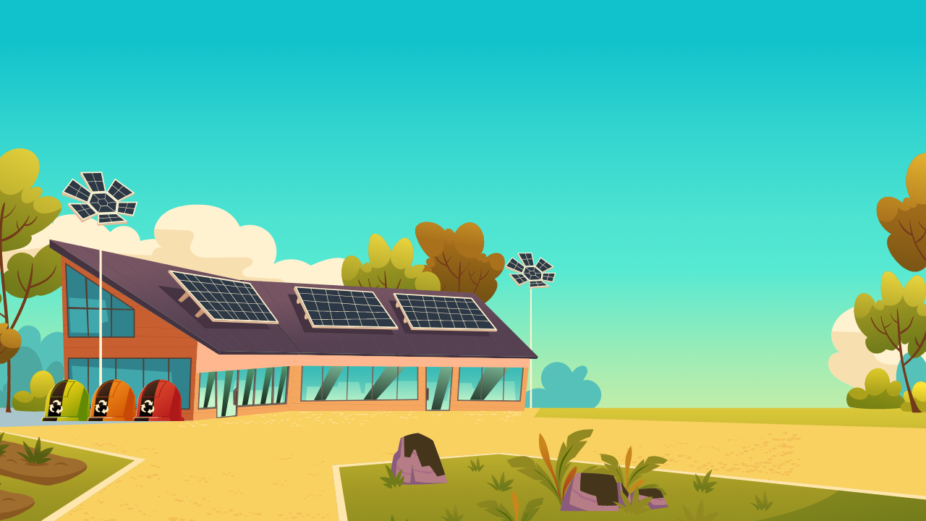
Oh wow, that actually sounds amazing. Count me in.
Love that! I’ll guide you through the DFP setup once your system’s ready. You're all set for now and I’ll be here every step of the way

Slide 10
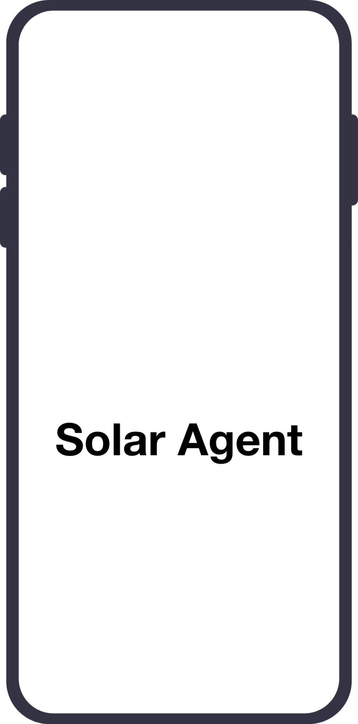
Seamless Onboarding Experience
You're all set!
SolarAgent will guide you through each step from subsidies to installation to the energy sharing program.
Thanks for choosing clean, smart energy.
From Enquiry To Subsidies
To Installation

